Slide 1
STRINGS

Slide 2
STRINGS
Sequenced Characters
single-quotes or double- quotes.
Python also provides triple-quotes to represent the string, but it is generally used for multiline string or docstrings.
'hello' is the same as "hello".

Slide 3
TYPE
Python is dynamically type.
Input is string

Slide 4
IMMUTABLE
Strings are immutable in Python.
The string object doesn't support item assignment i.e.
A string can only be replaced with new string since its content cannot be partially replaced.
We cannot delete or remove the characters from the string.
But we can delete the entire string using the del keyword.

Slide 5
STRING OPERATORS
Concatenation of Two or More Strings
Joining of two or more strings into a single one is called concatenation.
The + operator does this in Python.
The * operator can be used to repeat the string for a given number of times.
String Membership Test
We can test if a substring exists within a string or not, using the keyword in.

Slide 6
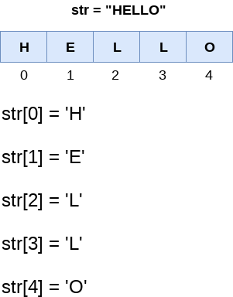
String indexing
indexing of the Python strings starts from 0.
Out of range

Slide 7
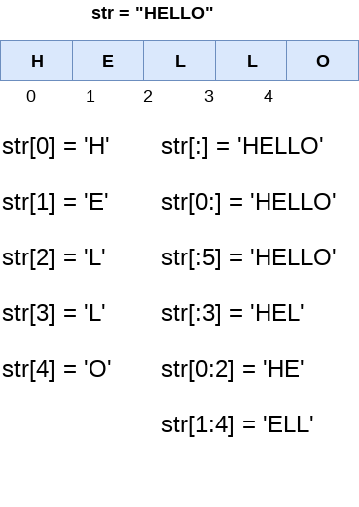
Slice Operator
use the : (colon) operator to access the substring from the given string.

Slide 8
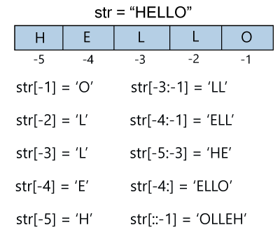
NEGATIVE INDEXING
it starts from the rightmost character, which is indicated as -1. The second rightmost index indicates -2, and so on.

Slide 9
NEGATIVE SLICING
the negative slicing in the string; it starts from the rightmost character, which is indicated as -1. The second rightmost index indicates -2, and so on.

Slide 10
String Methods
title()- It is used to convert the string into the title-case
istitle() - It returns true if the string is titled properly and false otherwise.
capitalize() - It capitalizes the first character of the String.
startswith(str,begin,end) - It returns a Boolean value if the string starts with given str between begin and end.
endswith(value ,start,end) - It returns a Boolean value if the string terminates with given suffix between begin and end.

Slide 11
Cont…
lower() - It converts all the characters of a string to Lower case.
islower() - It returns true if the characters of a string are in lower case, otherwise false.
casefold() - It returns a version of s suitable for case-less comparisons.
upper() - It converts all the characters of a string to Upper Case.
isupper() - It returns false if characters of a string are in Upper case, otherwise False.
swapcase() - It inverts case of all characters in a string.

Slide 12
Cont…
find(value ,beginIndex, endIndex) - It returns the index value of the string where substring is found between begin index and end index.
rfind(str,begin,end) - It is similar to find but it traverses the string in backward direction.
index(value, beginIndex, endIndex) - It throws an exception if string is not found. It works same as find() method
rindex(str,begin,end) - It is same as index but it traverses the string in backward direction.

Slide 13
Cont…
isalpha() - It returns true if all the characters are alphabets and there is at least one character, otherwise False.
Isalnum()-it returns true if all the characters are alphanumeric,meaning alphabet letter (a-z) and numbers (0-9)
isdecimal() - It returns true if all the characters of the string are decimals.
isdigit() - It returns true if all the characters are digits and there is at least one character, otherwise False.
Isnumeric()-it retturns true if all the characters are numeric (0-9),otherwise false.

Slide 14
Cont…
isidentifier() - It returns true if the string is the valid identifier.
ljust(width[,fillchar]) - It returns the space padded strings with the original string left justified to the given width.
rjust(width,[,fillchar]) - Returns a space padded string having original string right justified to the number of characters specified.

Slide 15
Cont…
strip([chars]) - It is used to perform lstrip() and rstrip() on the string
rstrip() - It removes all trailing whitespace of a string and can also be used to remove particular character from trailing.
lstrip() - It removes all leading whitespaces of a string and can also be used to remove particular character from leading.

Slide 16
Cont…
replace(old,new[,count]) - It replaces the old sequence of characters with the new sequence. The max characters are replaced if max is given.
zfill(width) - Returns original string leftpadded with zeros to a total of width characters; intended for numbers, zfill() retains any sign given (less one zero).
format(value) - It returns a formatted version of S, using the passed value.
count(value,start,end) - It counts the number of occurrences of a substring in a String between begin and end index.
join(seq) - It merges the strings representation of the given sequence.
len(string) - It returns the length of a string.

Slide 17
Cont…
split(str,num=string.count(str)) - Splits the string according to the delimiter str. The string splits according to the space if the delimiter is not provided. It returns the list of substring concatenated with the delimiter.
rsplit(sep=None, maxsplit = -1) - It is same as split() but it processes the string from the backward direction. It returns the list of words in the string. If Separator is not specified then the string splits according to the white-space.

Slide 18
STRING FORMATS
Python format() method is used to perform format operations on string.
While formatting string a delimiter {} (braces) is used to replace it with the value.
This delimeter either can contain index or positional argument.
Multiple Values
  to use more values, add more values to the format() method
Index Numbers
  can use index numbers (a number inside the curly brackets {0}) to be sure the values are placed in the correct placeholders
Named Indexes
  You can also use named indexes by entering a name inside the curly brackets {carname}, but then you must use names when you pass the parameter values

Slide 19
# Using Curly braces
print("{} and {} both are the best friend".format("Devansh","Abhishek"))
#Positional Argument
print("{1} and {0} best players ".format("Virat","Rohit"))
#Keyword Argument
print("{a},{b},{c}".format(a = "James", b = "Peter", c = "Ricky"))

Slide 20
Escape Sequence
SyntaxError as it contains both single and double-quotes.
The backslash(/) symbol denotes the escape sequence.
The backslash can be followed by a special character and it interpreted differently.
\n - linefeed
\’ - single quotes
\\” - double quotes
\b - backspace
\t -horizontal tab

